Slide 1
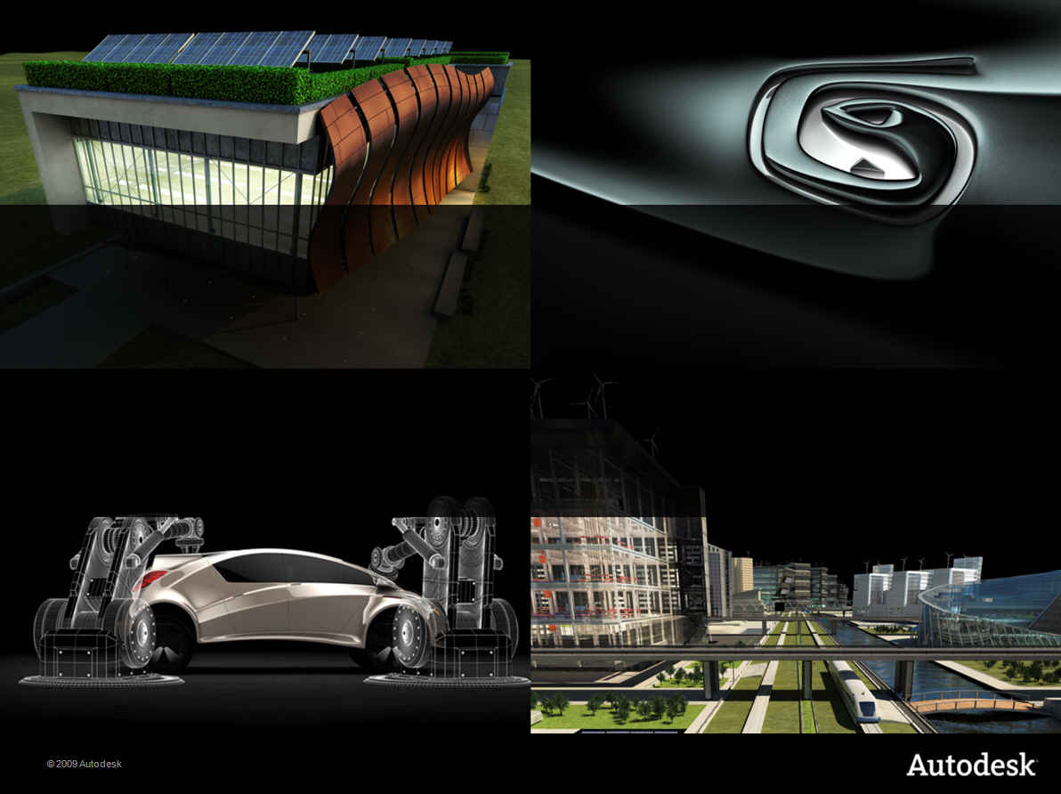
Choosing the Right Tool for the Job Up in the Cloud
Developer Days 2010

Slide 2
Inventor 2012 API

Slide 3
Name
Title

Slide 4

Bio
Describe

Slide 5
Nondisclosure Agreement
Today’s discussion is covered under your ADN Agreement with Autodesk.
The information we will be providing is highly confidential, and is to be shared within your company on “need to know basis” and to NO ONE outside your company.
Autodesk makes no guarantees that anything presented or discussed will actually appear in the future.

Slide 6
What’s New in Inventor 2012?
48 new objects (with 619 new functions)
41 removed functions
303 new functions on existing objects
5 modified functions
Inventor 2010
137 new objects (with 1925 new functions)
121 Removed functions
900 new functions on existing objects
44 modified functions.
Inventor 2011
57 new objects (with 537 new functions)
21 removed functions
635 new functions on existing objects
53 modified functions

Slide 7
Inventor API Survey Results
76 responses
Preferred Development Tools
Version of Inventor used
Language | Votes | Percent | Pro Votes | Pro Percent
C++ | 12 | 16% | 9 | 53%
VBA | 22 | 29% | 3 | 18%
Visual Basic 6 | 7 | 9% | 0 | 0%
VB.NET – Visual Studio | 25 | 33% | 5 | 30%
VB.NET – Visual Basic Express | 20 | 26% | 2 | 12%
C# – Visual Studio | 25 | 33% | 4 | 24%
C# – Visual C# Express | 5 | 7% | 0 | 0%
Other | 5 | 7% | 2 | 12%
Version | Votes | Percent
Inventor 2008 | 2 | 3%
Inventor 2009 | 3 | 4%
Inventor 2010 | 29 | 38%
Inventor 2011 | 42 | 55%

Slide 8
Inventor API Survey Results
Areas to focus development
Other: Vault, event enhancements, Cable & Harness, Add-In loading
Drawings | 47 | 62%
User Interaction | 39 | 51%
Other, Please Specify | 24 | 32%
Assemblies | 21 | 28%
User Interface | 21 | 28%
Part Features | 18 | 24%
Client Graphics | 11 | 14%
2D Sketches | 9 | 12%
B-Rep query and creation | 9 | 12%
3D Sketches | 6 | 8%

Slide 9
Part Enhancements

Slide 10
Extrude Feature Re-Design
Now uses the “Definition” concept.
Provides full support for all functionality.
Old API still supported for backward compatibility.
' Create an extrude definition.
Dim extrudeDef As ExtrudeDefinition
Set extrudeDef = extrudes.CreateExtrudeDefinition(rectProfile, kNewBodyOperation)
' Modify the extent and taper angles.
Call extrudeDef.SetDistanceExtent(8, kNegativeExtentDirection)
Call extrudeDef.SetDistanceExtentTwo(20)
extrudeDef.TaperAngle = "-2 deg“
extrudeDef.TaperAngleTwo = "-10 deg"
' Create the extrusion.
Dim extrude As ExtrudeFeature
Set extrude = extrudes.Add(extrudeDef)
Notes:
Demo: modPart.NewExtrude
The extrude feature has been re-designed to use a “definition” as input. This allows the API to provide support for new settings and to easily handle any enhancement that are made to the feature in the future. An example of this is the recent ability to have multiple solid bodies in a single part. When creating an extrusion interactively you can specify which bodies the extrusion should apply to. This wasn’t supported through the API when you’re creating a feature because the Add methods didn’t have an argument to provide this information. It would have meant creating new add methods to add this argument, with the possibility go through the process again in the future if the extrude feature is enhanced.
With the definition approach, you create an ExtrudeDefinition object and use it’s methods and properties to all of the various options of an extrude feature. The Add method takes the ExtrudeDefinition as it’s single input. Properties and methods can be easily added to the definition object in the future to support new functionality.
Features that have more recent API support already use this definition concept. For example, all of the sheet metal features. More of the older features will be converted over in future releases.

Slide 11
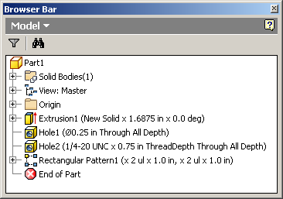
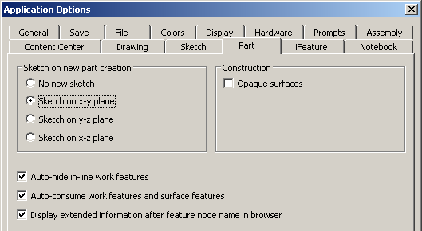
Other Part Enhancements
Additional options of derived part supported.
Support for creation of silhouette curves in 3D sketch.
Support for creation and edit of rib features.
Can get anchor points of dimension constraints and feature dimensions
PartFeature.ExtendedName
Notes:
Demo: modPart.CreateSilhouetteCurve
Demo: modPart.CreateRib
Derived part now supports more of the functionality available through the user-interface. The following properties were added.
DerivedPartDefinition.ActiveDesignViewRepresentation
DerivedPartDefinition.ReducedMemoryMode
DerivedPartDefinition.UseColorOverridesFromSource

Slide 12
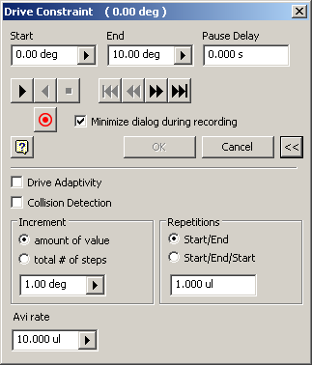
Assembly Enhancements
Full support for drive constraint.
Can fully define the settings.
Can drive the animation.
Can create an animation file.
Interference calculation now returns the body(s) of interference.
Notes:
Demo: modAssembly.CreateDriveConstraint
Demo: modAssembly.RunDriveConstraint
The API now supports the equivalent functionality of the user-interface in the Drive Constraint command.
Demo: modAssembly.CreateInterferenceResults
Can now get the body(s) that represent the volume of interference between parts in an assembly.

Slide 13
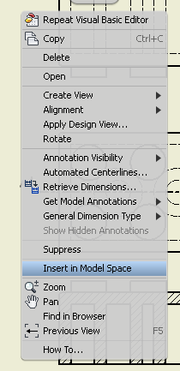
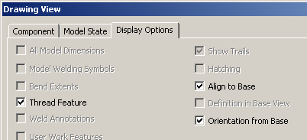
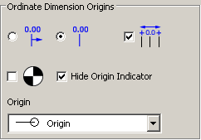
Drawing Enhancements
Full support for revision tables.
DrawingView.InsertInModelSpace
DrawingView.ViewOrientationFromBase
DimensionStyle.OrdinateDimensionOriginArrowheadType
OrdinateDimensionSet.OriginArrowheadType
Notes:
Full support for revision tables. Previous API had basic support but full access to the table and its settings is now provided.
Some additional API capabilities to provide equivalent functionality to the user-interface.

Slide 14
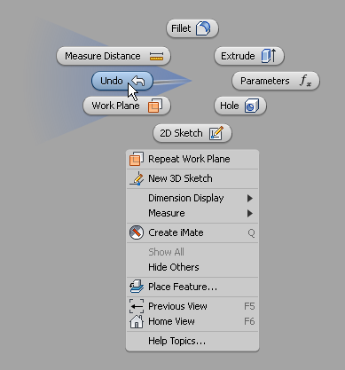
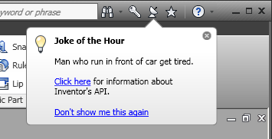
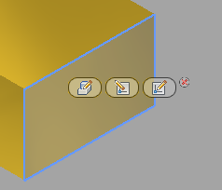
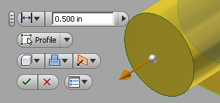
New User-Interface
Marking Menu
Mini toolbar
Contextual mini toolbar
Balloon Tips
Notes:
With Inventor 2011 and 2012 several new user-interface elements have been added. Then Inventor 2012 API provides access to all of this functionality so that you can incorporate them into your applications.

Slide 15
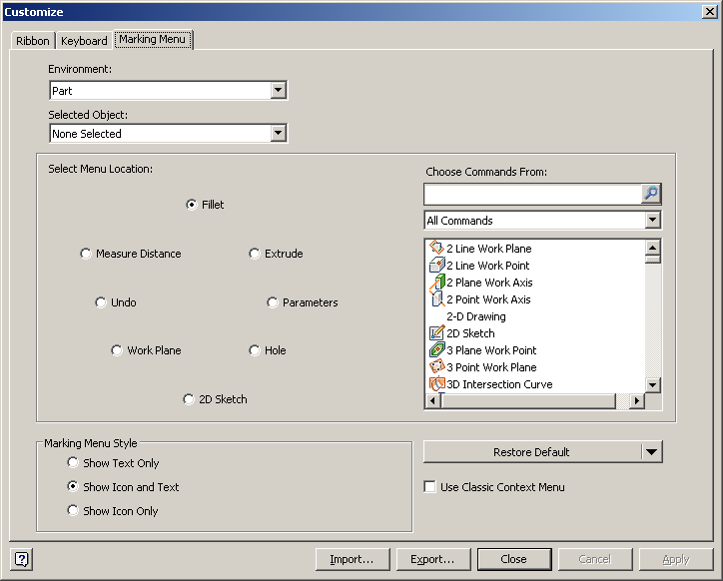
Marking Menus
Marking menu
Radial marking menu
Linear marking menu
Replaces Context Menu
Radial marking menu is customizable by the user.
You need to update any existing programs that use the OnContextMenu event.

Slide 16
Radial Marking Menu
Environment.GetRadialMarkingMenu returns the default marking menu for a specified object type.
Can edit to modify the default contents.
Object types for Inventor defaults
2D sketch, 3D sketch, Edge, Face and Surface, Placed features, Sketched features, Standard Component, Work Feature
You can also create a default definition for any object type.
Limited to a set of 8 commands but you can have sub-menus.
Can listen to UserInputEvents.OnRadialMarkingMenu event to dynamically modify the contents.
Notes:
Demo: modUI.EditRadialMenuForWorkPoint
Creates a default radial marking menu for a workpoint.
Demo: modUI.StartMarkingMenuSample, modUI.StopMarkingMenuSample
Demonstrates dynamically editing the radial marking menu. While this is running, right-clicking on a vertex will now display a new button in the East position that is a pop-up for another radial menu.

Slide 17
Linear Marking Menu
Can listen to UserInputEvents.OnLinearMarkingMenu event to dynamically modify the contents.
Looks and works very much like the previous context menu.
If option “Use Classic Context Menu” is set then only linear marking menus will be shown.

Slide 18
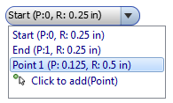



Mini Toolbar
Ability to create floating, transparent replacements to dialog interfaces.
Supports:
Apply, OK, Cancel buttons
New lines and separators
Button
Check box
Combo box
Drop-down
Value editor
Supported within an command (InteractionEvents) and at Application level (CommandManager).
Notes:
Demo: StartMiniToolbarSample, StopMiniToolbarSample
The sample can be run in any context and demonstrates creating a generic mini toolbar.

Slide 19
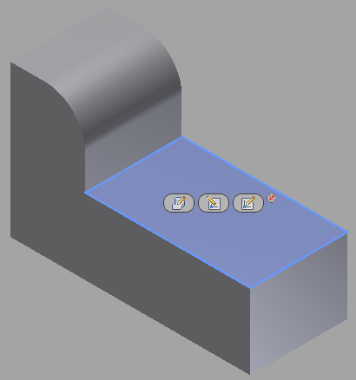
Contextual Mini Toolbar
Displayed when the user selects an object.
Quick access to commands commonly used for selected entity.
Respond to UserInputEvents.OnContextualMiniToolbar to edit the contents of the mini toolbar.
Each button shown consists of a command and an associated list of entities to highlight.
Notes:
Demo: StartContextMiniToolbarSample, StopContextMiniToolbarSample
After starting the command and selecting a face, an additional button is displayed for the “Delete Face” command. It will delete the selected face and all faces that are tangentially connected.

Slide 20
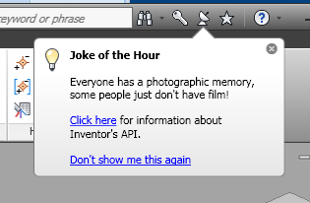
Balloon Tips
Display message in communication center balloon.
Can use as timed message by specifying the time between pop ups.
Can have links within the message.
Notes:
Demo: StartBalloonTip, StopBalloonTip
Once started the message will pop up every 10 seconds with a different joke.

Slide 21
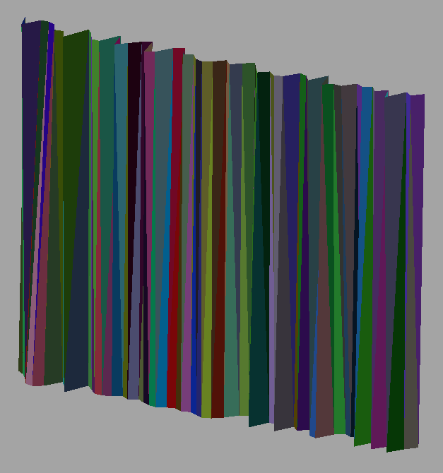
Non-Transacting Client Graphics
Support for non-transacting client graphics.
No undo support.
Significantly faster than transacting client graphics.
Sample creates 1000 unique triangles with accompanying coordinates, normals, etc.
Transacting: 17.52 sec.
Non-transacting: 0.159 sec.
Over 100 times faster.
Notes:
Demo: NonTransactingGraphics
Change the value of the createAsTransacting variable to have it create transacting client graphics.

Slide 22
Registry-Free Add-Ins
Registering of add-ins is no longer needed and is not recommended.
Add-in needs to support registry-free COM.
The add-in wizard will create a registry free add-in.
Documentation is provided to show how to convert existing add-ins (VB, C#, and C++) to be registry-free.
.addin file defines the various settings that used to be defined in registry.
Add-in dll can be placed anywhere
.addin file needs to be placed in the correct directory and specify where add-in dll is located.

Slide 23
.addin File Locations
Version Independent
Windows XP:
C:\Documents and Settings\All Users\Application Data\Autodesk\Inventor Addins\
Windows7/Vista:
C:\ProgramData\Autodesk\Inventor Addins\
Version Dependent
Windows XP:
C:\Documents and Settings\All Users\Application Data\Autodesk\Inventor 2011\Addins\
Windows7/Vista:
C:\ProgramData\Autodesk\Inventor 2011\Addins\
Per User Override
Windows XP:
C:\Documents and Settings\<user>\Application Data\Autodesk\Inventor 2011\Addins\
Windows7/Vista:
C:\Users\<user>\AppData\Roaming\Autodesk\Inventor 2011\Addins\

Slide 24
New Add-In Loading Mechanism
Problem: Add-In loading is a significant part of Inventor start-up time.
Solution: Add-in loading is delayed until it is needed.
Default behavior is to load add-ins on Inventor startup.
Recommended behavior is to delay load so the user doesn’t pay performance/memory penalty until the add-in functionality is used.
This requires add-ins to use the new registry-free add-in loading mechanism.
Certain add-ins (such as PDM applications) may still need to load on startup.

Slide 25
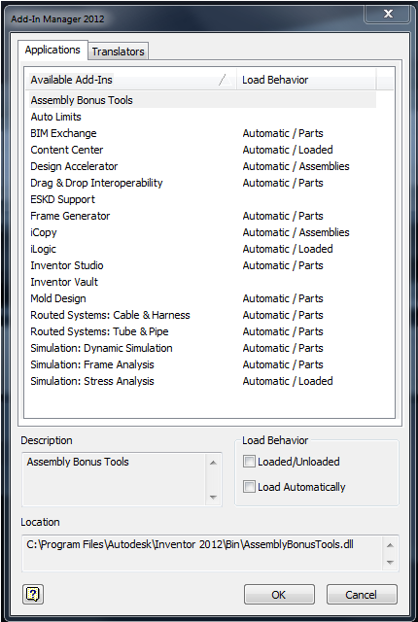
Add-In Load Behavior
Immediately
Loads on start up (not recommended)
Parts
Assemblies
Presentations
Drawings
Loads when first part document of that type is opened.
Specified in the .addin file.

Slide 26
BIM Exchange API
API provides access to the same functionality as through the user-interface.
Notes:
Demo: modBIMExchange.DefineComponentAndExport
BIM Exchange (previous AEC Exchange) now supports an API. You have access to all of the same functionality that you have through the user-interface.

Slide 27
New Transient Camera
Previously, the only way to get a camera is from a View.
Create images without a view. Useful in Apprentice.
Private Function GetImage(ByVal Filename As String) As Image
' Create an instance of Apprentice.
Dim apprentice As New Inventor.ApprenticeServerComponent
' Open the specified file.
Dim appDoc As Inventor.ApprenticeServerDocument = apprentice.Open(Filename)
' Create a camera.
Dim cam As Inventor.Camera = apprentice.TransientObjects.CreateCamera
' Associate the camera with the part's component definition.
cam.SceneObject = appDoc.ComponentDefinition
' Set the camera to the desired orientation and position.
cam.ViewOrientationType = Inventor.ViewOrientationTypeEnum.kIsoTopRightViewOrientation
cam.Fit()
cam.ApplyWithoutTransition()
' Create an image. Can also use SaveAsBitmap to save the image directly to a file in one of several formats.
Dim picDisp As stdole.IPictureDisp
picDisp = cam.CreateImage(1000, 1000)
' Return the image.
Return Microsoft.VisualBasic.Compatibility.VB6.IPictureDispToImage(picDisp)
End Function
Notes:
Demo: ApprenticeCamera VB.Net sample

Slide 28
Dockable Window Enhancements
Control the caption of the window.
Specify whether the title bar should be shown or not.
Event notification for:
OnHelp to display your own help.
OnShow when a dockable window is displayed.
OnHide when a dockable window is closed.

Slide 29
Transient Geometry Enhancements
Plane.IntersectWithSurface
TransientGeometry.CurveCurveIntersection
TransientGeometry.CurveSurfaceIntersection
TransientGeometry.SurfaceSurfaceIntersection

Slide 30
Miscellaneous
View.RayTracing
DisplayOptions.UseRayTracingForRealisticDisplay
DisplaySettings.UseRayTracingForRealisticDisplay
GroundPlaneSettings.FrontDirection
GroundPlaneSettings.UpDirection
RepresentationEvents.OnActivateDesignView
RepresentationEvents.OnNewDesignView
MassProperties.RotationToPrincipal

Slide 31
Questions & Answers

Slide 32
Today’s presentations…
ADN Extranet
http://adn.autodesk.com
Under “Events”

Slide 33
Nondisclosure Agreement
Today’s discussion is covered under your ADN Agreement with Autodesk.
The information we will be providing is highly confidential, and is to be shared within your company on “need to know basis” and to NO ONE outside your company.
Autodesk makes no guarantees that anything presented or discussed will actually appear in the future.

Slide 34

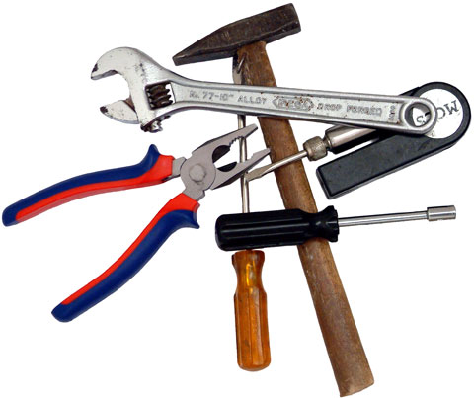
Choosing the Right Tool for the Job Up in the Cloud

Slide 35
Choosing the Right Tool for the Job Up in the Cloud
Developer Days 2010

